Slide 1


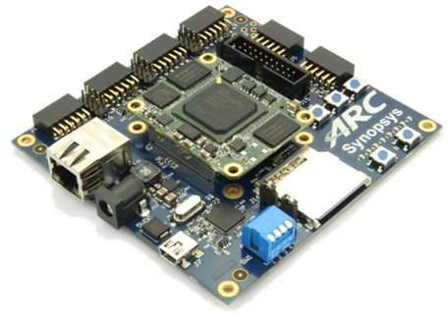
2019 Synopsys ARC AIoT Design Contest

Slide 2
Project Name – DUI Monitoring System
Smart & Safe Vehicle
Arun Singhal, Rishab Ravi and Aditya Nad
13th June, 2019

Slide 3
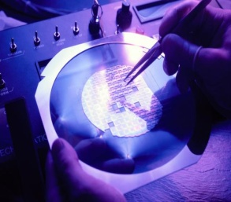
Agenda
Project Abstract
Project Challenge and Creativity
Design Description
System Analysis and Testability
Block Diagram
Circuit Diagram with connections to IOT kit
MQ3 sensor (signal conditioning, placement & range, working)
Calibration and Measurement (MQ3 sensor)
Face Detection Algorithm
Summary

Slide 4

Project Abstract
“Every year in the U.S. alone, drunk driving claims approximately 10,000 lives and costs approximately $194 billion”. This project seeks to offer a solution to minimize this global issue via a DUI monitoring system designed for vehicles.
The system consists of a gas sensor to check for alcohol consumption and a camera to monitor drowsiness. Demonstrated by a demo car gradually coming to a halt if alcohol was sensed.

Slide 5
Project Challenge and Creativity
Creativity
Effort to make the DUI system more foolproof via appropriate incorporations
Multi sensor, multi parameter measurement.
Challenges
Positioning of sensors
Placement of camera
Configuring the ARC IoTDK

Slide 6
Design Description
Requirements:
a) Hardware:
1) ARC IoT Development Kit
2) MQ3 alcohol sensor
3) Web camera
4) Basic circuit design components (resistors, LEDs)
5) DC Motors (BO 100rpm)
9) Chassis
10) Wheels
b) Software:
1) embARC Open Source Platform
2) MetaWare Development Toolkit & GNU Toolchain
3) Python + OpenCV (for computer vision)
4) Putty
5) Digilent Adept

Slide 7
Working in-brief:-
The MQ-3 alcohol sensor (breath analyzer sensor) checks if the driver has consumed alcohol. Depending on the output of the sensor, the vehicle is brought to a gradual halt (considering the speed of the vehicle so that it’s not an inconvenience).
A webcam monitors the driver and checks for drowsiness via face-detection and eye aspect ratio.
The system is also set to inform the respective authorities via e-mail if the driver is not in a position to drive (drowsy).

Slide 8
System Analysis and Testability
For pilot study a model is designed with breath analyzer and image processing, by making use of a home assembled toy car with DC motors for motion.
A cap dipped in alcohol will be used to provide an input to the MQ-3 gas sensor. An red LED glows on detecting the driver to be under the influence of alcohol.
The camera uses facial recognition and computer vision to detect drowsiness in the driver. The system shoots out an email to the authorities if the driver is caught drowsy.

Slide 9
BLOCK DIAGRAM
START
Test for alcohol in breath.
Wait for 5 mins
If Test Positive
INNOCENT
YES
Turn on parking signals
Start the alcohol over limit indicator & trigger the alarm
Gradually decrease car speed to 0km/h
Restrict engine ignition
NO
DRUNK
YES
Is Vehicle moving
NO
No alarm is triggered
Engine can be ignited
No speed limit is set
Location, car details, driver details and time are sent to the registered contacts
Turn off the engine
Restrict the engine ignition
Limit car speed to 0km/h
Start the over-limit indicator
Turn on the alarm
END

Slide 10
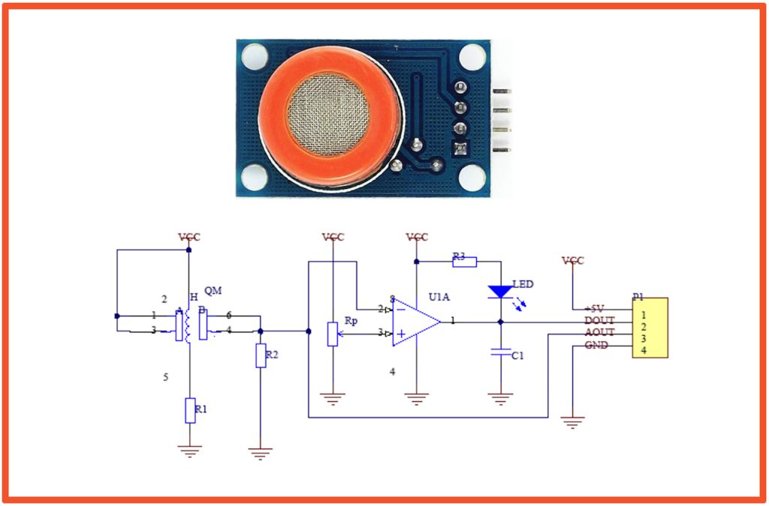
Circuit Diagram
MQ-3 Sensor
courtesy: https://www.instructables.com/id/HackerBox-0035-ElectroChemistry/

Slide 11
MQ3 sensor
The MQ-3 gas sensor would be placed on the steering wheel. The distance between the sensor and the driver would be 30-50cm. The MQ-3 sensor can sense presence of alcohol gases at concentrations from 0.05mg/L to 10mg/L. It’s conductivity increases as the concentration of alcohol gases increases. It has high sensitivity to alcohol and has a good resistance to disturbances due to smoke, vapor and gasoline. This module provides both digital and analog outputs. It has a high sensitivity and fast response time.
Why MQ3?
5V operation
Simple to use
LEDs for output and power
Output sensitivity is adjustable
Analog output 0V to 5V – can be calibrated to indicate level of BAC of driver
Digital output 0V or 5V – 0V means no alcohol detected while 5V means alcohol detected (triggering amount can be configured)
Low cost
Good sensitivity to alcohol gas
Drawback-
Owing to the high sensitivity, it is very difficult to calibrate and stabilize.

Slide 12
Calibrating the MQ3 Sensor
The MQ-3 gas sensor was calibrated by giving it an input draft after consumption of known amount of alcohol and checking for the analog output and setting the threshold for the digital output.

Slide 13
System on ARC IoTDK
A motor driver IC (L293d) was used to control the speed of the DC motors via pulse width modulation. We make use of 9V batteries to power the motors.
GPIOs on the IoTDK were used to configure the LED and the MQ-3 gas sensor.
If the driver tests positive to the breathe analyzer test the reducing speed of the motors can be seen in an output on the serial monitor (Putty).
A “0” value input on GPIO4B_2[1] from the MQ-3 gas sensor indicates the driver testing positive to the breathe analyzer test. Shouldn’t drive! The system will slow the car down.
A “1” value input on GPIO4B_2[1] from the MQ-3 gas sensor indicates the driver testing negative to the breathe analyzer test. Can drive!
The value of GPIO4B_2[1] is also displayed on Putty as pin 1.

Slide 14
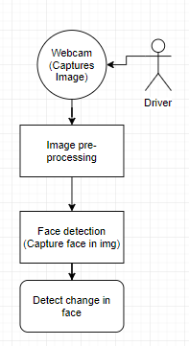
Face Detection
Driver images are initially fed into the system and the model is then trained to recognize the person via face-detection.
The webcam to be mounted on the steering wheel monitors the driver and alerts when the driver appears to be drowsy via eye aspect ratio.
OpenCV was used for the development purposes.

Slide 15
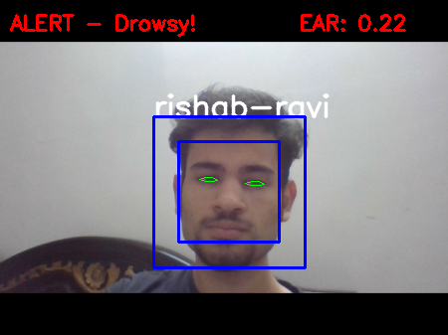
Camera Monitoring
The camera serves a two-fold purpose – 1. detecting the driver via face detection 2. Alert when the driver is drowsy.

Slide 16
Summary
This project uses the ARC IoTDK to create a DUI detection/monitoring system for vehicles via the use of an MQ-3 gas sensor and Computer Vision.
A working prototype of the proposed project was developed.
This project could be taken further by processing the drowsiness application directly on the EmbARC Board.

